Slide 1

Kaiser Local Capacity Development Grants
Cohort Session #1– Essential Nonprofit Management Tools: Unveiling the Core of Nonprofit Success
July 11, 2024

Slide 2


Session Facilitator
Cynthia N. Cortez
(She/Her)
Director of Learning and Innovation
Center for Nonprofit Management
ccortez@cnmsocal.org

Slide 3
Cohort Learning Sessions Schedule
Thursdays, 2-4pm on Zoom Platform
Module | Topic | Date
 | Kick-Off Meeting | 6/4/2024
1 | Essential Nonprofit Management Tools: Unveiling the Core of Nonprofit Success | 7/11/2024
2 | Authentic Leadership: Managing Competing Priorities While Staying true to your Values | 9/12/2024
3 | Strategic Insight: Planning and Evaluating Programs for Effective Decision-Making | 10/10/2024
4 | Effective Marketing and Communication: Intentional Storytelling for Diverse Audiences | 12/11/2024
5 | Expanding Your Resource Strategy: Innovating Funding Solutions | 1/30/2024
6 | Strategic Partnerships and Collaborations for Collective Impact | 3/13/2024
Notes:
Attend live
Emphasize group collaborations / learning from each other
Recording for inclusion purposes
Hope: Attend for the real time experience

Slide 4
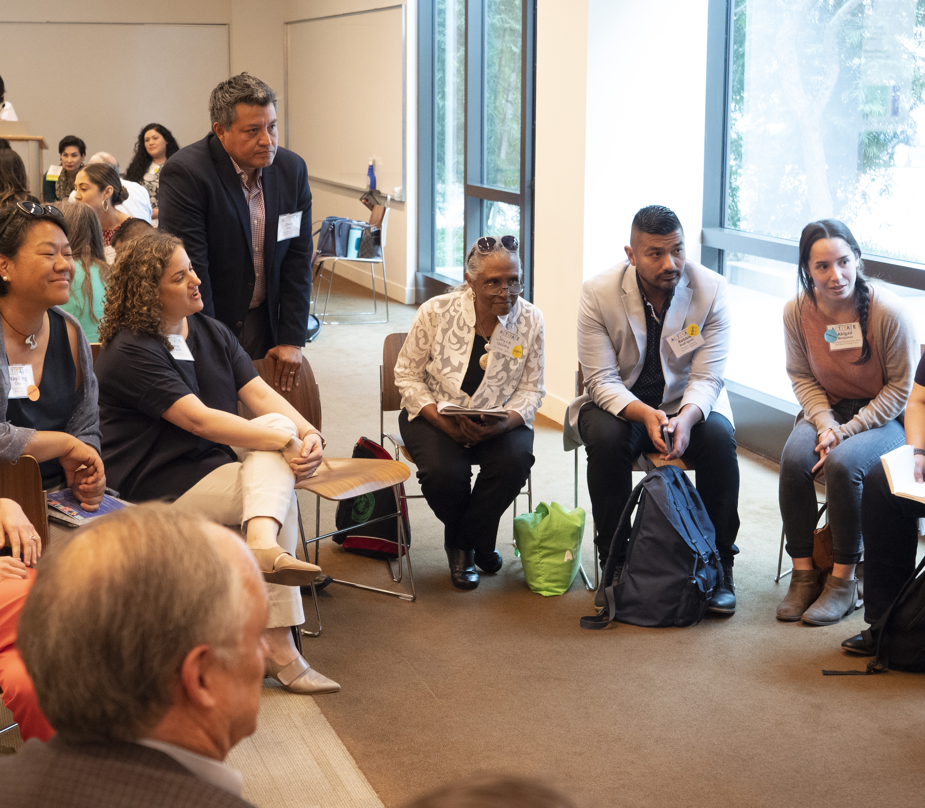
Session Focus Essential Nonprofit Management Tools: Unveiling the Core of Nonprofit Success
Nonprofit Foundations
Strategic Planning
Capacity Building

Slide 5

Welcome
Welcome, Recap, and Cohort Invitations
Activity: Cohort Relationship Building
Nonprofit Essentials
Getting to Goals: Strategic Planning
Best Practices: Capacity Strengthening
Poll: Capacity Strengthening Areas
Breakout Room Activity: Case Study
Recap, Closing, Resources, and Next Steps
Notes:
Cynthia

Slide 6
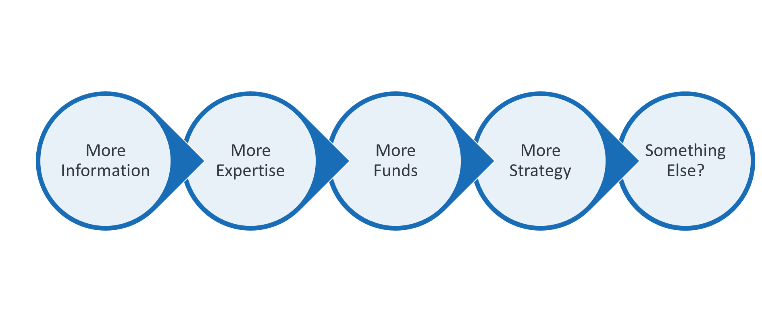
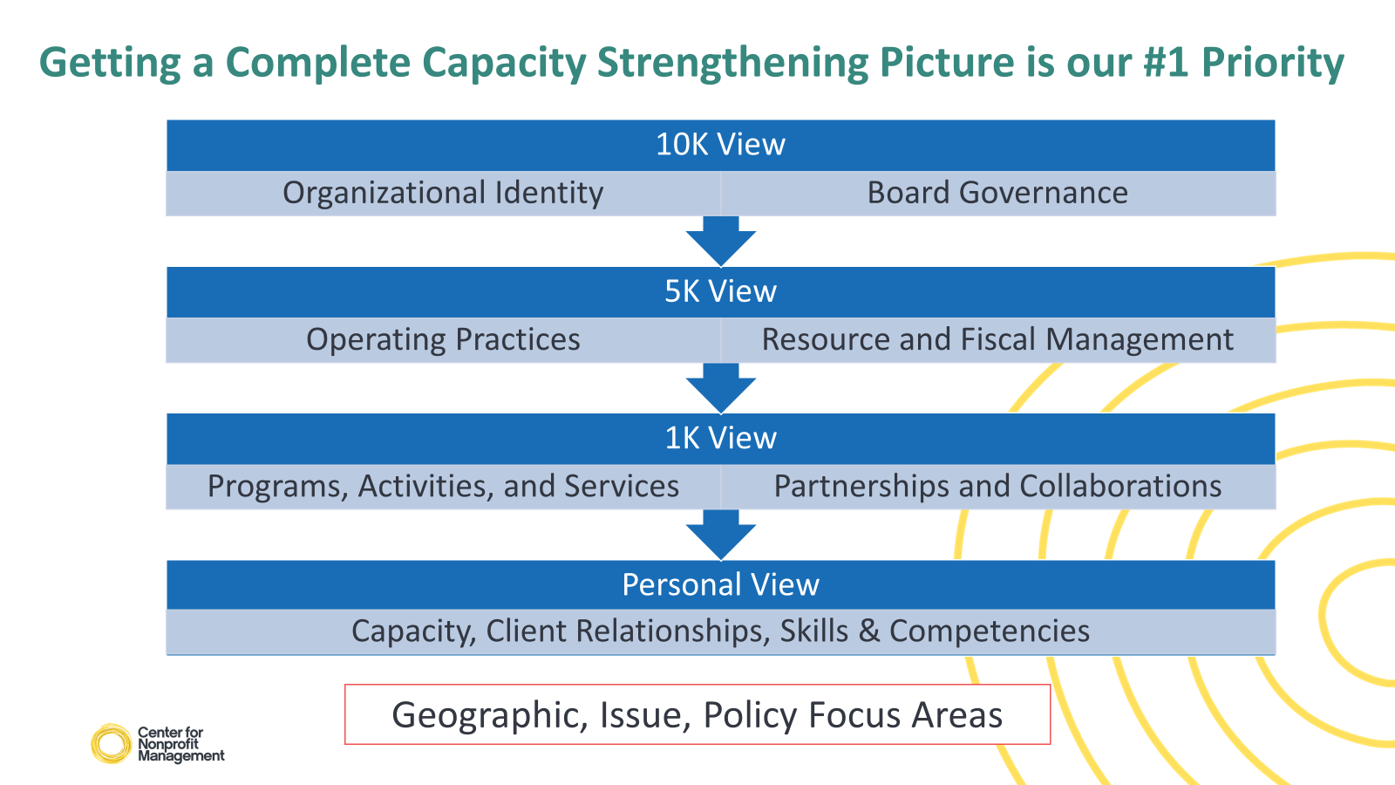
A kickoff into the breadth and depth of where we can go
Notes:
Our goal is about building your organizational capacity on a broader scale. The experience you will have will help you not only for the goal(s) you choose, but serve as a resource at large, beyond this partnership.
Additional Details:
Kaiser: Stage of cohort: They are in Year 2 of the grant
Orgs were recommended to apply; moved through a selection process
Kaiser can share criteria used:
Member of community network of Thrive Local
Community health managers also recommend orgs who meet the criteria to apply
Equity lens was used: Board composition (BIPOC representation); target population (communities of color); etc.
We can refresh what this means (grant funding opportunities, highlights of some orgs, what Kaiser has heard in regards to capacity development needs
Community resource network and global statistics
Referral status, etc.
Orgs are key referring agencies (CBOs)
Vision: Think about capacity building in a broader scale (not only the grant)
High-level regrounding of grantees – Develop capacity of organization
Introduce CNM
FYI: This used to be called Thrive Local – new name

Slide 7
Cohort Community Invitations
Engage: Be present for yourself and colleagues
Use the chat, emoji reactions, etc. frequently
Turn your camera on
Listen: Open your ears and hearts
Share: Experiences, questions, and validations
Make the Mic Inclusive: Allow others to speak and participate
Humility: Respect others’ perspectives with curiosity
Truth: Speak with honesty and recognize other’s truths
Ongoing Growth: Seek resources to get to your destination
Be descriptive and precise: Minimize “high-inference” language

Slide 8
Connect with you cohort member:
Ask them their story of how they entered the nonprofit sector. Learn what they are most passionate about.
Conclude with what you want to learn/grow in for the remainder of 2024
Breakout Rooms
8 mins – Pair Share
8

Slide 9
Nonprofit Essentials

Slide 10
Nonprofit:
“A nonprofit organization address social issues by reinvesting revenues into its mission. It forms partnerships and mobilizes resources to deliver services that promote equity and improve quality of life. Through evidence-based and innovative solutions, nonprofits meet diverse community needs, fostering resilience and empowerment. They are committed to social good and advocate for underserved populations.” – Working Definition, CNM

Slide 11
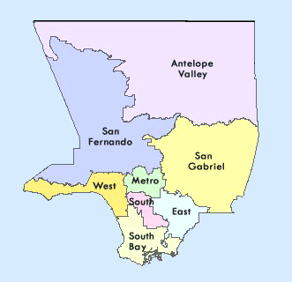

Nonprofit Organizational Identity A Solidifying Societal Role
Advocacy Efforts:
Nonprofits as community’s safety net
Improving the fiscal relationship between nonprofits and government
Influence policies given their expertise of community needs
47,000 nonprofits in the county
83 Billion in Revenue
Notes:
118 years old to 1 year in operations
10 staff members to 400

Slide 12
“Mission, vision, and strategy are the agents that power your purpose and direction. A strong, focused mission and a clear understanding of your organization’s brand identity is key. Focused organizations keep their constituency in mind. They are able to articulate value and tie strategy to mission and organizational capacity.”
– CNM Answer Guide: Leadership and Innovation
Mission
Operating Budget
Vision
Activities and Services
Operational Maturity
Your organizational identity and management practices are the foundations to strengthening your capacity
Notes:
Your mission captures your issue and activity focus areas
Your vision reveals your operational capacity to transform comunity

Slide 13
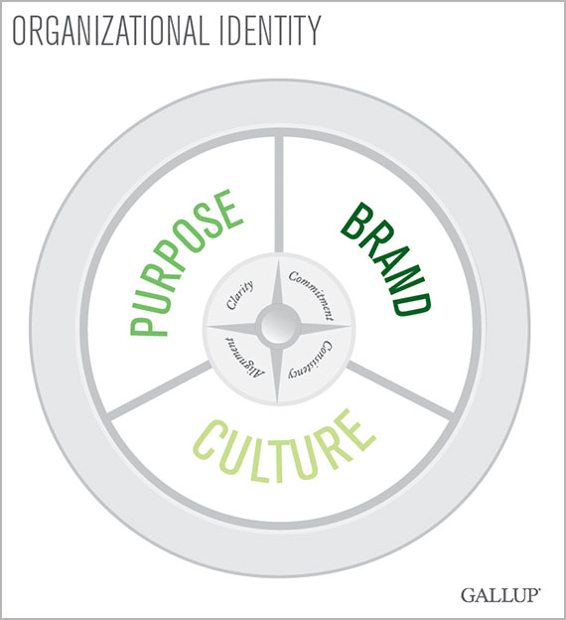
In 2024 and Beyond: Mission Refresh?
Clarity
Commitment
Consistency
Alignment
Notes:
Style guide: https://fenton.com/act/styleguide2023/

Slide 14
In 2024 and Beyond: Mission Refresh?
Does your mission… | Potential Action Steps:
Contain a list of activities you do? | Distill the list into core categories
Explain how you do your work? | Highlight your unique approach
Language considered respectful? | Review your language within today’s social context
Convey specificity of the work that you do? | Examine “high inference” terms and use more concrete ones
Relay a succinct message? | Get to the essence of what you do
Easily remembered by your staff and board of directors? | Run exercises to help staff state your mission statement with confidence

Slide 15
Keep the Doors Expanding: Core Nonprofit Documents
Legal Documents
Articles of Incorporation (core purpose and activities)
Bylaws
Rules, structures, and procedures on how the nonprofit will run
Meeting Minutes
Serves as official business records: conversations and decisions
Financial Records
Defines relationships, duties, and responsibilities of people who will manage the nonprofit
Form 990 and Taxes
Helps onboard new board members to understand how business is conducted
Statement of Activities (Income Statement)
Financial position
Cash flow
Functional expenses
Workers’ compensation
Insurance
General Liability
Property
Auto/vehicle
Professional Liability
Audits
Federal and State status compliance
Notes:
These may not seem unfamiliar to y’all but when we get into the nitty gritties of them, this is where we tend to identify pain points
Compliance is key to expanding grant opportunities.
FINANCIAL TERMS:
501(c)(3) Status: A U.S. Internal Revenue Service (IRS) designation granted to eligible nonprofit organizations that meet specific criteria, allowing them to be exempt from federal income tax. It also enables donors to make tax-deductible contributions in support of the organization's mission. This status is subject to meeting IRS requirements, including operating for specific charitable or educational purposes and adhering to regulatory standards.
IRS Form 990: A required annual tax document that nonprofit organizations submit to the IRS. It offers a comprehensive overview of the organization's finances, governance, and operations, enhancing transparency for donors and the public. This form enables individuals to evaluate the organization's financial stability, mission, and governance practices. Nonprofits are required to complete and disclose Form 990 to maintain their tax-exempt status.
Annual Financial Audit: A comprehensive examination of the organization's financial records, transactions, and internal controls. This audit aims to verify the accuracy, transparency, and compliance of the organization's financial statements with accounting standards, legal mandates, and reporting requirements.

Slide 16
Nonprofit “Business” Functions Central Administration | Governance | Programming
Accounting Practices & Tax Policies
Payroll and HR
Overhead and Development
Board of Directors
Programs and Services
Partnerships and Collaborators
Professional Services
Organizational Chart
Operational Systems, Audits, Technology
Marketing and communications
Strategic planning and growth management
Funders, donors, clients, partners
Workplace culture
Team Dynamics
Mission / Vision
When stretched too thin, neglect may occur, and weakening can begin….
Notes:
Upskill/Specialized Professional Development
Stabilize Capacity: Programs, Services, and Staff
Diversify Resources and Funding Sources
Adopt Inclusive Workplace Culture Practices
Strengthen fundamentals: HR, Finance, Legal
Expand into NEW issue/operational area

Slide 17
Getting to Goals: Strategic Planning

Slide 18
On Strategic Planning
Steer Your Organization’s towards the right degree of operational maturity
A strategic plan is a documented process that determines organizational decision-making priorities
Identity | Central Administration | Governance | Programming
Requires intentional strategy to get from the current reality to the envisioned future:
What do we have today?
What will we need tomorrow?
What is the most optimized build- out of our organization?
Too often placed to the side in response to real-time opportunities and pressures (sitting on the shelf)
Notes:
Here we see conversations of scaling.

Slide 19
Factors that Impact Strategic Planning
Board/ Leadership Request – First Strategic Plan
Need to demonstrate organizational maturity
Hard Pause
Reality vs. Vision
Aspirations
Increase trust with community / clients
Stronger fiscal standing
Clear reputation
Grant Requirement/ Bonus Tool
New ED/CEO: New Vision, New Direction
Vibrant organizational cultures
Expired Plan
Committed, Engaged, Well Developed Employees
Revamp Mission/ Vision Statements
Notes:
Reality: Fund / cash flow challenges; leadership commitments to a strategic planning approach to org growth (vs. organic); organizational pressures (i.e. staff turnover)

Slide 20
On Strategic Planning
The process merits Board, Leadership, Staff and Stakeholder Involvement to:
Budget Resources
Prioritize Efforts
Allocate of Time
Honestly Reflect
Reorient towards the vision
Notes:
Convolution and/or competing priorities
Unclear process, poor project management, ill-defined deliverables
Ambiguous “must-have” components:
Strategic framework?
Strategic plan with measures?
Strategic actions with responsible point person?
Timelines that make sense: 3-year, 5-year, 10-year plans?
Clash of perspectives
Different people, different needs, different asks
Organizational culture: Behaviors when it comes to planning and monitoring

Slide 21
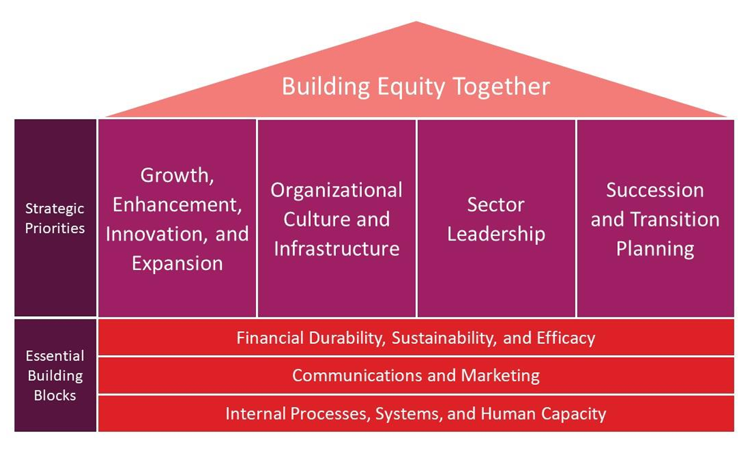
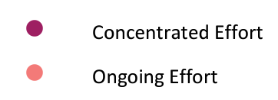
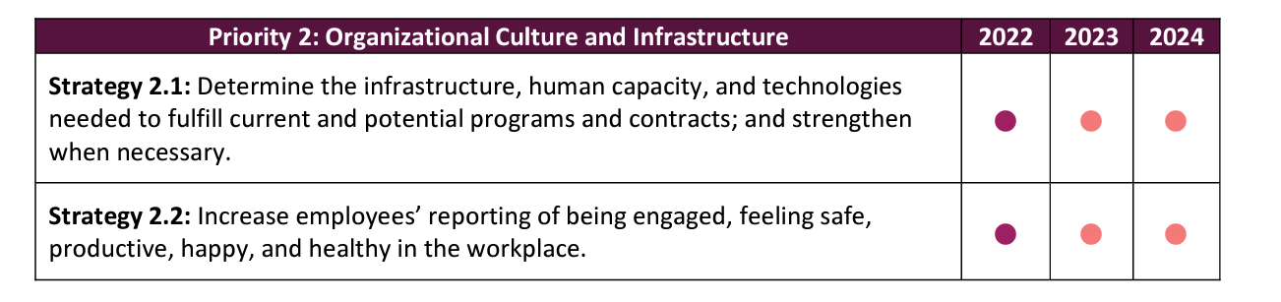
Example of a Strategic Plan
Details:
6 month experience
Taskforce of 13 people – staff and board members
Honest reflection of successes and organizational pain points
Data collection: 80 stakeholders
3-year plan keen on actions > how

Slide 22
Break time!
5 mins

Slide 23
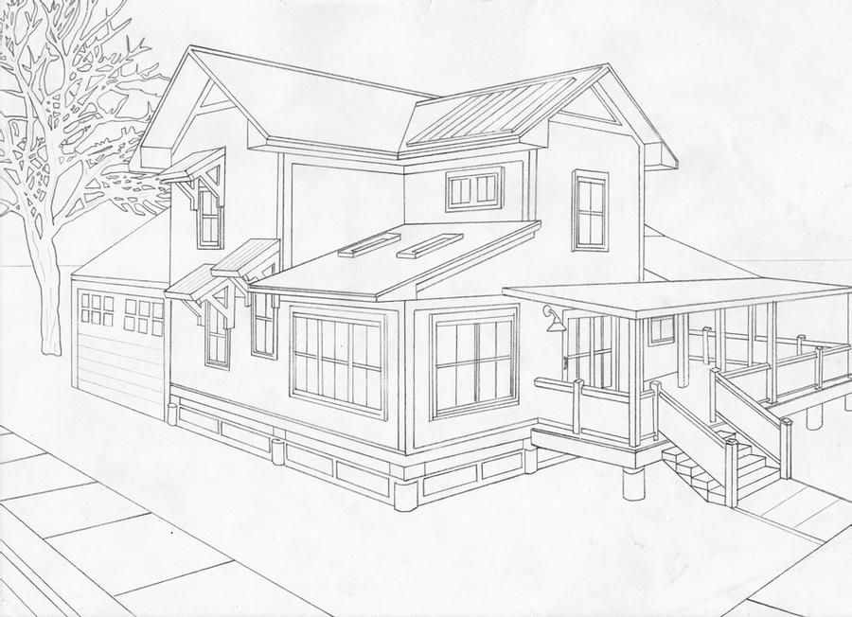

Sustainability is KEY in the Nonprofit Social Impact Sector
What is nonprofit capacity strengthening?
Activities that help you fulfill your mission
(Services)
Activities that help you sustain yourself (Operations)
Notes:
There is a difference between effectiveness and operational capacity.
Other areas that are emerging n

Slide 24
All Capacity Areas are Interconnected
Traditional Nonprofit Area | Capacity Activities
Organizational Identity | Mission, vision, strategic planning, scenario planning, organizational assessment and development
Governance and Leadership | Board engagement, succession planning, leadership & professional development, partnership and community engagement, bylaws
Program Effectiveness | Program design, implementation, and evaluation; Marketing and communications, data management practices, referrals and collaborations, subject matter expertise
Resource Development & Financial Practice | Fund development practices, diverse funding sources, revenue-generating activities, grant writing, cash reserves, financial reports, asset management
Internal Operations and Management | Human resources management, financial management, technology systems, legal procedures, volunteer engagement, facility maintenance
Notes:
There is a difference between effectiveness and operational capacity.

Slide 25
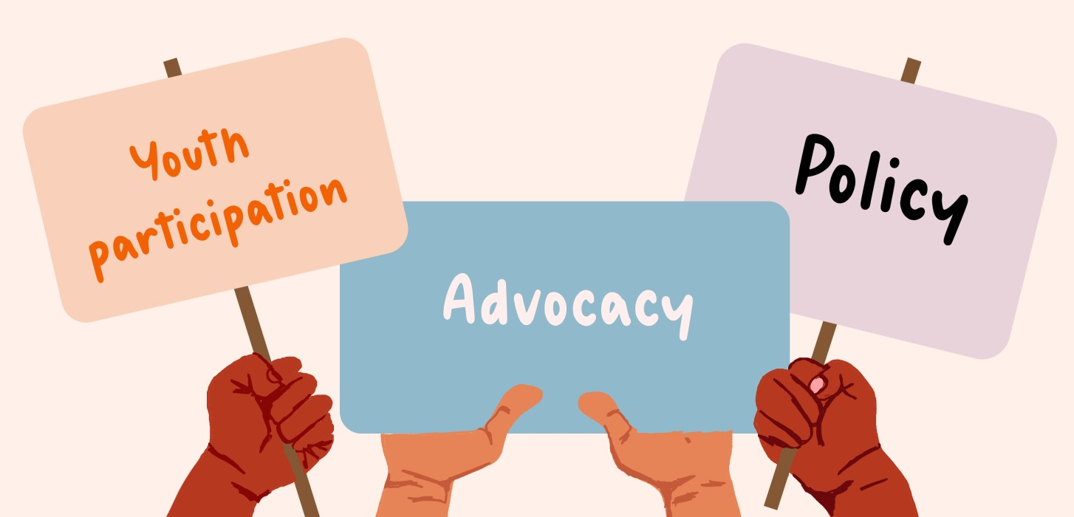
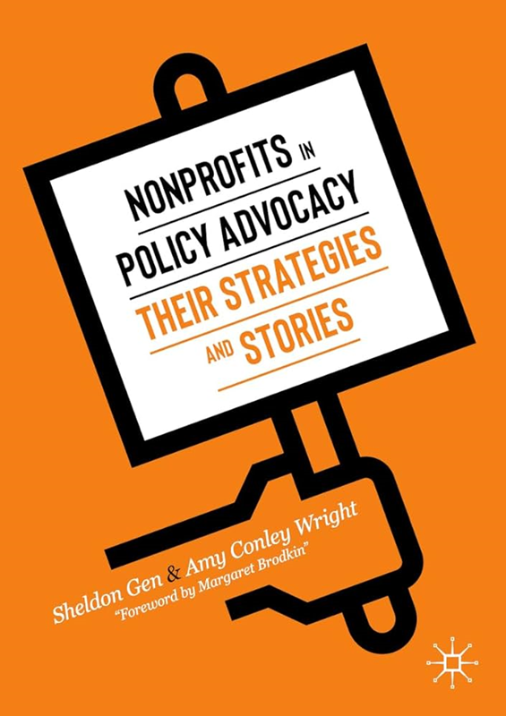
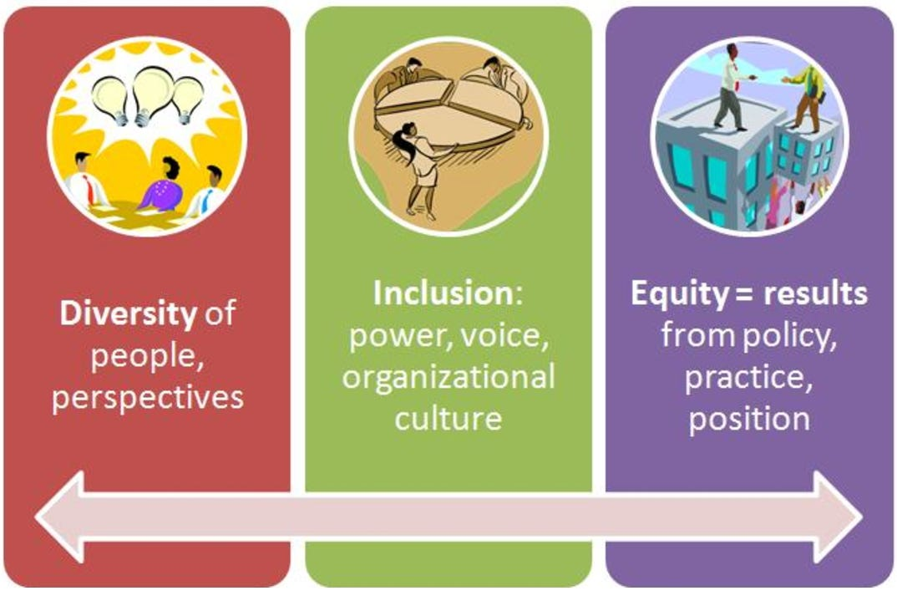
Emerging Capacity Areas
Let’s Discuss a core concept that links advocacy to DEI…

Slide 26
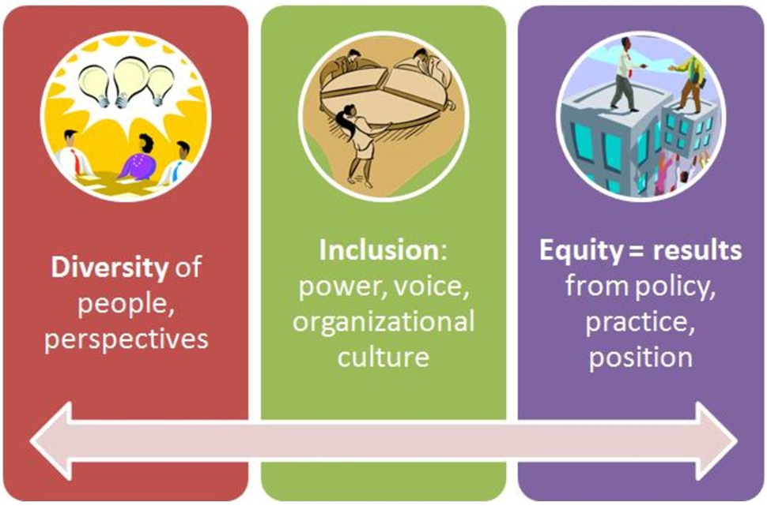
Capacity strengthening considerations from an equity-perspective
Each of us practice a culture – or combination of cultures that impact our behaviors, worldviews, and interests.
One skill to engage with people who are not like us is called:
Cultural Competence

Slide 27
Cultural Competence Definition From: Black Men Heal
Cultural competency is a way of understanding and appreciating cultural differences. Cultural competence is the ability to work respectfully with people from diverse cultures, while recognizing one’s own cultural biases.
Cultural humility is the ability to recognize one’s own limitations in order to avoid making assumptions about other cultures. It also includes acknowledging one’s own culture and its strengths and weaknesses.
Cultural awareness involves developing knowledge about different cultures, including their beliefs, values, customs, and language.

Slide 28
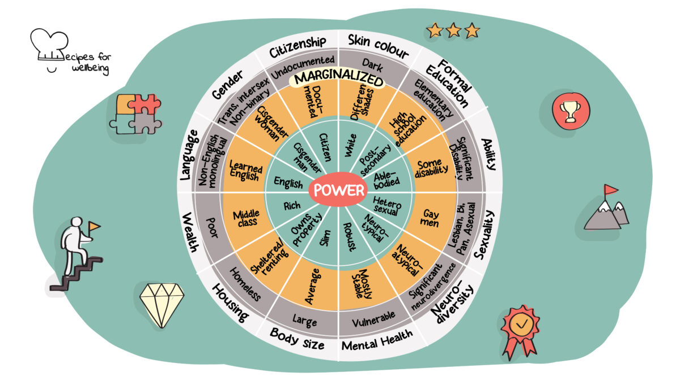
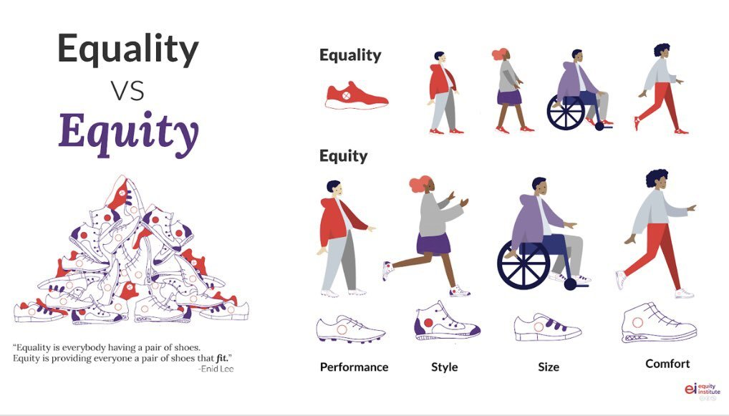
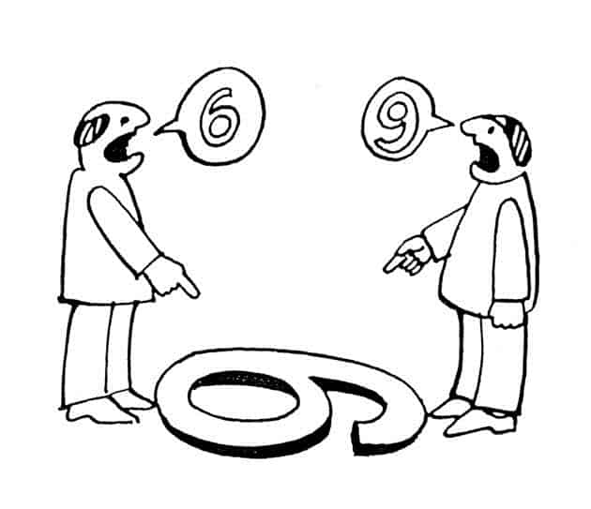
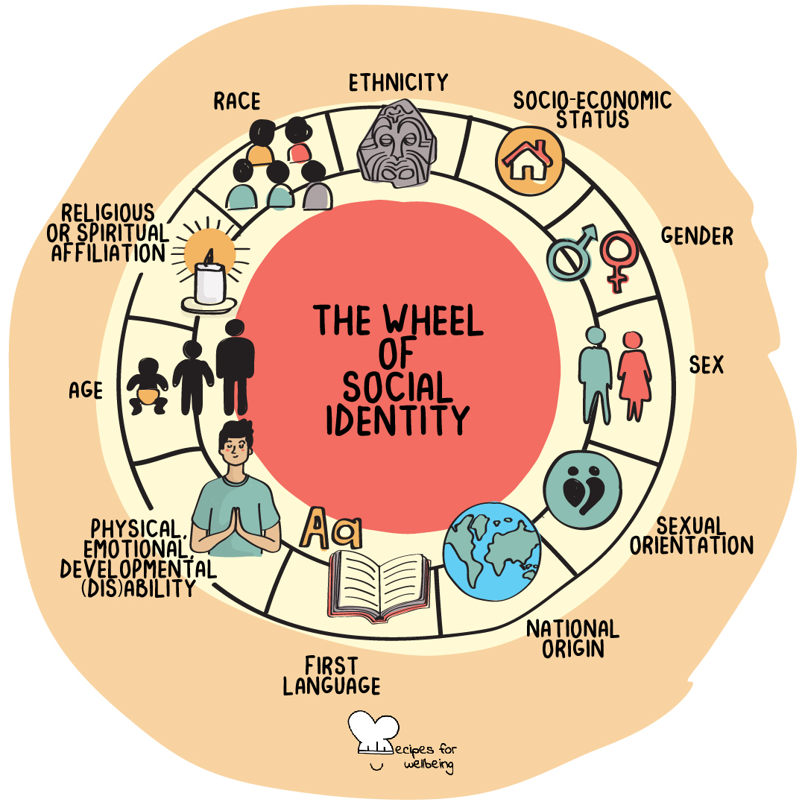
What does this mean?
Notes:
We all have identities…each identity has power and privilege → Those help us understand the reality
In PRACTICE, we develop unique stances and perspectives which led to realities

Slide 29
How does cultural competence connect to nonprofit capacity? It impacts decision making
Your worldview heavily influences what you think is real, valid, and worthwhile
People trust and build relationships when they feel seen and respected
Organizations may have leaders who see things differently than community
Notes:
1) Leadership – do you listen and acknowledge perspectives from individuals who are not like you? Do you understand other realities and needs?
2) Relationships – people know when you are genuine. Centering others needs require show up authentically – and this can be very uncomfortable.
3) Priorities – needs step from lived experiences. Humility is required to acknowledge needs that will benefit the collective.

Slide 30
What nonprofit capacity area do you think you will focus on during your technical training assistance experience?
Poll
30

Slide 31
Case Study and Breakout Room Activity

Slide 32
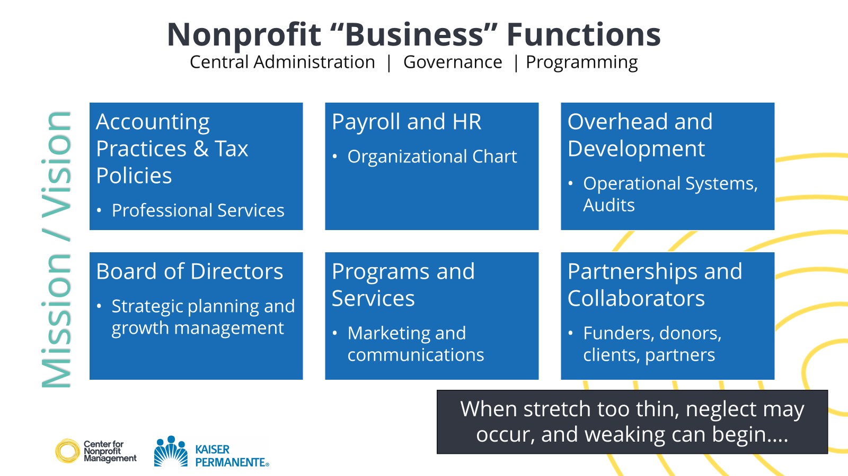
Case Study and Breakout Room Activity

Slide 33
Breakout Room Activity
Your small but mighty organization is receiving a lot of feedback from community. Front line staff has raised the following at all staff meetings:
Community Voices:
Clients are increasingly vocalizing how day-to-day life is tougher and tougher: rent is too high, health wellness is a challenge, and that they wish resources were more abundant.
Some community members have shared courageous feedback on the quality of support they receive from the organization. They are frustrated that the services are “not enough” even though they understand that the organization can’t solve all of their problems.

Slide 34
Breakout Room Activity
You are a senior leader tasked to improve the client experience. When you start gathering feedback from staff you hear:
Colleague A: “I can’t imagine adding another program. Data collection is cumbersome. I wish leadership would finally invest in technology that will help us serve more, efficiently.”
Colleague B: “We can be in a better situation if we hired more staff – and retained them. The pressure to scale up without a real strategy to do this sustainably is frustrating.
Colleague C: “What community is saying is real but I don’t think our organization is ready for an honest conversation of root causes and real change. We do not talk about diversity, equity, and inclusion issues head on.”
Colleague D: “The board is more focused on securing more money than the state of our programs and services. We’ve raised this issue for years.”

Slide 35
Diagnose the Issue,
Pitch a Solution
Dissect the situation. Name at least three dynamics at hand.
As a group, name one core problem that the organization will respond to.
As a team:
Pitch one solution.
What actions do you think will be easy and which ones hard?
What resources will you need?
Activity
Breakout Rooms
15 minutes – 3-4 persons
35
Notes:
Facilitate in chat or verbally what beauty was heard. Notetaker needed.

Slide 36

Report Out
Notes:
Did y’all pick up: a mission issue? A communication issue? A governance issue? A staff turnover one?

Slide 37
Next Steps

Slide 38
Fun, rejuvenated energy, learn from colleagues
Skills – Management, Communications, Reach
Concepts that Stand Out
Navigating the Tension: Decisions that center org needs vs. staff ones
Everyone should understand resourcing and fund management
Holding accountability to plans and commitments
Shifting staff behaviors to new organizational workflows
Strengthen Infrastructure
Partnerships to Increase Service Capacity
Staff Leadership
Organizational Goals
Organizational Needs Assessment Preliminary Findings

Slide 39
Needs Assessment & Tailored Technical Assistance (TTA)
Needs Assessment Survey
Identification of top main focus area
Commit to action steps diagnosing realities to navigate possibilities
Pause and Reflect:
Re-strategize and refine actions towards success
State successes and honor challenges: Identify next steps

Slide 40
Tailored Technical Assistance
Sign up Via Calendly Link
First Session
Second Session
Third Session
Fourth Session
Due by Jul 2024
Due by Dec 2024
Due by Feb 2025
Due by Apr 2025
Progress check and troubleshooting
Assessment of successes and next steps
Identify main issues and establish strategy
Progress check and troubleshooting
Notes:
You will be given a calendly link to sign up for session

Slide 41
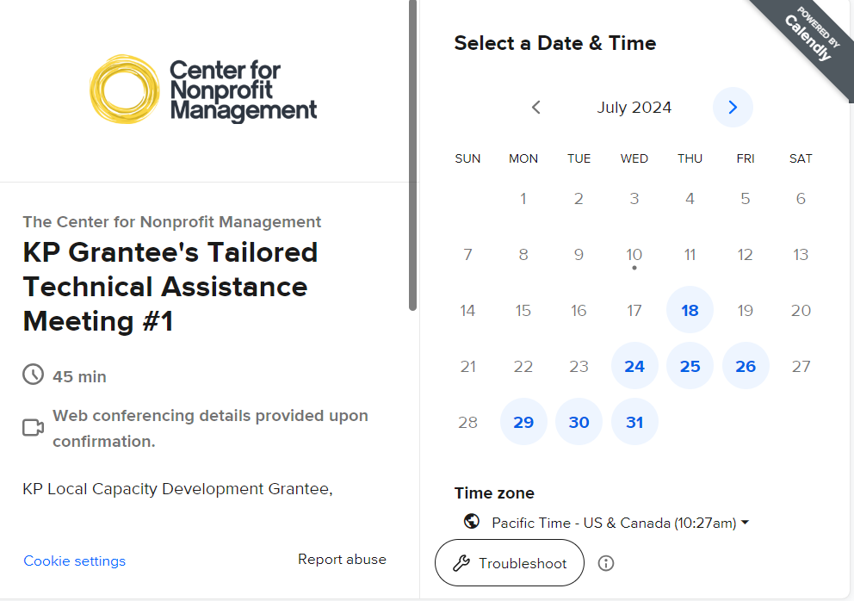

Slide 42
Best Practices on the Process of Building Capacity Inspired by: Network for Nonprofit and Social Impact: Nonprofit Capacity: A Guide for Foundations
Identify a specific capacity development area and focus energy and resources on it. You may have several paint points but pick the area that will have the greatest impact in this moment.
You cannot do it all at once. One build out at a time.
Capacity building is action and decision oriented. It requires monitoring of change processes, talent, modification of budgets, shifts in leadership practices, and sometimes organizational culture change.
Leadership clarity and communication strategies are critical
Notes:
SKIM BY THIS FAST – present reference slides

Slide 43
Best Practices on the Process of Building Capacity Inspired by: Network for Nonprofit and Social Impact: Nonprofit Capacity: A Guide for Foundations
Use needs assessments to address your area of concern concretely and intentionally. To truly diagnose a high-need, high-impact area, honesty is essential.
“I don’t know what I don’t know.”
Create an implementation plan for your capacity building effort. Milestones should be documented. Key actors should be named.
“A goal without a plan is just a wish.”
Notes:
SKIM BY THIS FAST – present reference slides

Slide 44
Best Practices on the Process of Building Capacity Inspired by: Network for Nonprofit and Social Impact: Nonprofit Capacity: A Guide for Foundations
Measure/qualify success. Navigation will always bring unanticipated situations. Know what success must look like from the start and make room for lessons learned.
Don’t move the success goal post but recognize the wins that come with progress
Capacity building is iterative – you may need several attempts to be successful
Notes:
SKIM BY THIS FAST – present reference slides

Slide 45
Resources

Slide 46
Vital Nonprofit Management Resources
Expand Your Learning: Resources
Center for Nonprofit Management’s Learning and Events Center
BoardSource’s Nonprofit Mission Statement
Council of Nonprofits
National Council of Nonprofits’ Diversity on Nonprofit Boards Article
Management Consulted’s Cultural Humility and Why it Matters
Indigenous Vision’s Cultural Humility

Slide 47
Expand Your Learning: Resources
Center for Nonprofit Management Answer Guides:
Board and Governance
Jitasa’s Nonprofit Financial Statements: 4 Essential Reports to Know
Harvard Business Review’s Why Diverse Teams are Smarter
CalNonprofits’s Essential Insurance Types for California Nonprofits
Stanford Social Innovation Review’s (SSIR) How Nonprofits Get Really Big
Fenton’s 2023 People and Identity Style Guide

Slide 48
Expand Your Learning: Resources
Network for Nonprofit and Social Impact: Nonprofit Capacity: A Guide for Foundations
TED Talk on Social Innovation and the Nonprofit Sector: Don Pallotta’s The Way We Think About Charity is Dead Wrong
Beyond the Myths: Mastering Nonprofit Technology Strategies
Stanford Social Innovation Review Podcasts: Nonprofit Management
Podcast: Nonprofit Pulse’s “The 3 Pillars of Nonprofit Capacity Building – Kimberly Thornbury, the Murdock Trust”

Slide 49
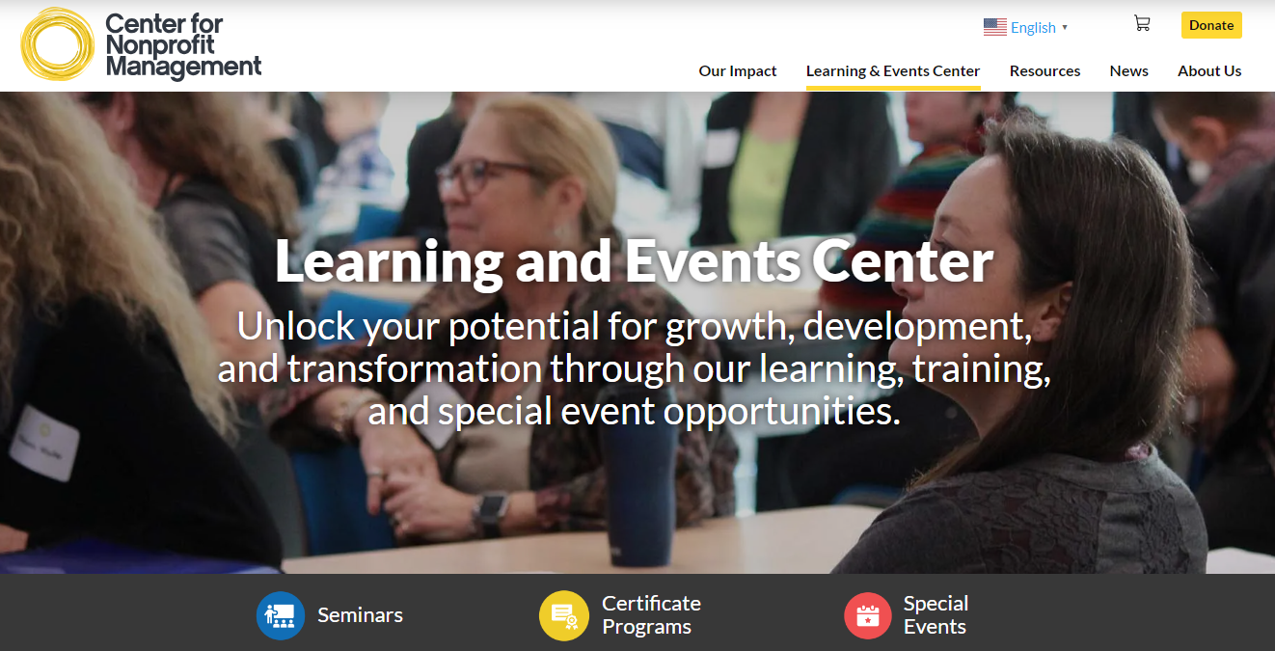
Thank You and Session Evaluation
https://cnmsocal.org/learning-and-events-center/
Cynthia N. Cortez
Director of Learning and Innovation
Center for Nonprofit Management
ccortez@cnmsocal.org
Fill out the session's evaluation: https://www.surveymonkey.com/r/LQNQYHS

